Slide 1
Physically-Based Simulation
Project: Waterboat
Group: PhysIT
Phillip Løjmand, Daniil Emtsev, Anton Maksimov

Slide 2
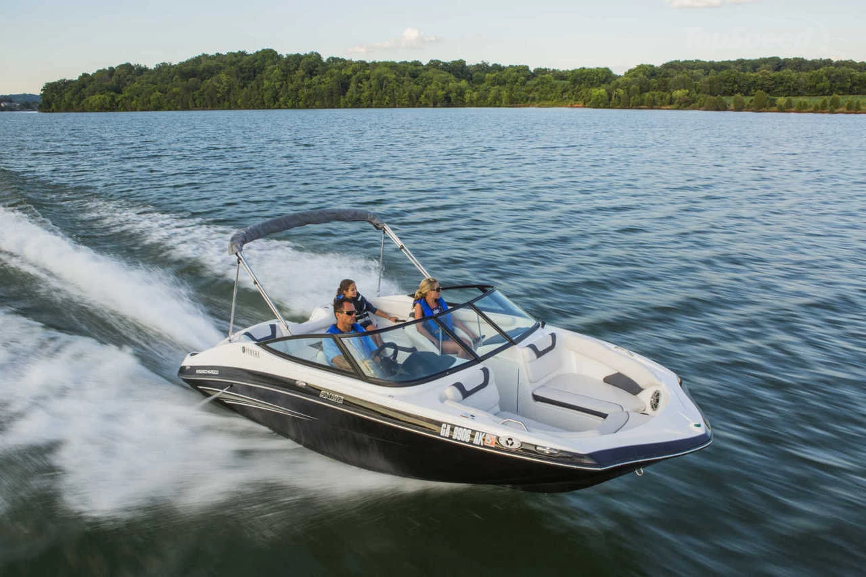
Simulation scenario
Water/boat simulation and controls
Motivation: Implement realistic boat controls for video games.
Implementation of particle based water simulation, coupling of fluid and rigid bodies, external control forces.

Slide 3
Simulation methods
Particle-based fluid modeling (SPH).
Both way fluid-rigid body coupling.
Forces:
Water suction/propulsion for jet engine controls. Water disappears/appears with motion.
External wave generating forces.

Slide 4
Minimal target
Moving water simulation.
Floating rigid body boat.

Slide 5
Desired target
Moving water simulation.
Floating rigid body boat.
Hydro powered jet engine effect that causes splashes/creases in the water.
Engines also affect the boat as controls.

Slide 6
Bonus target
Moving water simulation.
Floating rigid body boat.
Hydro powered jet engine effect that causes splashes/creases in the water.
Engines also affect the boat as controls.
Water ocean rendering.
Large wave simulation which the boat can jump of off.
Multiple real time boats with rigid boat/boat collisions.

Slide 7
Milestones
Add a container with unrendered simulated water in 3D.
Introduce a boat that floats.
Attach a suction/expulsion mechanism to the boat.
Add motion controls caused by propulsion of 2 engines.
Render the water so it looks like the ocean.
Add an external force that generates large waves.
Balance performance/realism to achieve real time controls.
Introduce multiple boats.
Implement rigid body collision between boats.

Slide 8
Questions?

